Slide 1
End of Summer Presentation
Krishnan R. Luhar

Slide 2
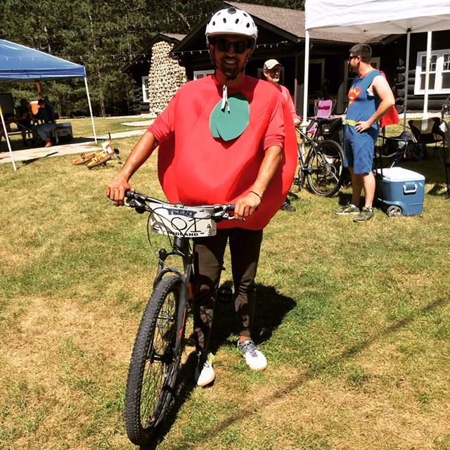
About Me
Going Into Senior Year at Michigan State, Mechanical Engineering
From Diamond Bar, CA
Basketball, Golf, Mountain Biking
Second Lowest Movie List Percentage
Lowest between department interns
Almost cried during the meat mountain initiation
Please Ask Questions at Any Time

Slide 3
Table of Contents
Contact Pattern Fixture
3D Printer
EPS Driven
Miscellaneous Tasks

Slide 4
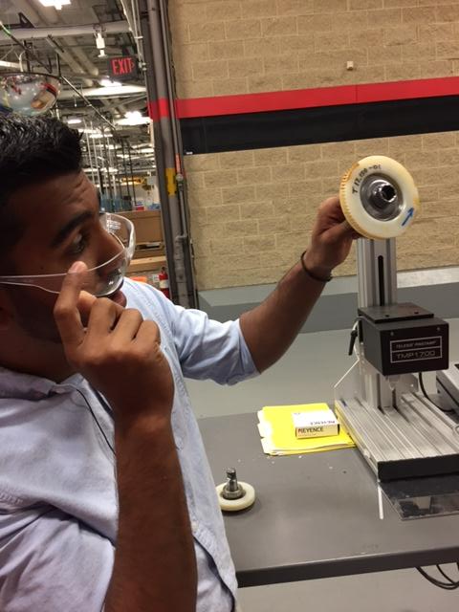
Contact Pattern Fixture: Problem
High FTQ rates in plants
Downsides of current process
Subjective rather than objective
Inconsistent
Language barrier
Lack of traceability
Notes:
High FTQ rates for 24:1 programs
Can be applied to all programs
Beginning middle end take pics and upload to excel file 12 hours time difference
10pm at night when they start shift
Not allowed to start unless contact looks good

Slide 5
Contact Pattern Fixture: Objective
Lower FTQ rates
Detect bad contact quicker/more efficient
Prevent poor production days
Help engineering judgment when adjusting gear parameters

Slide 6
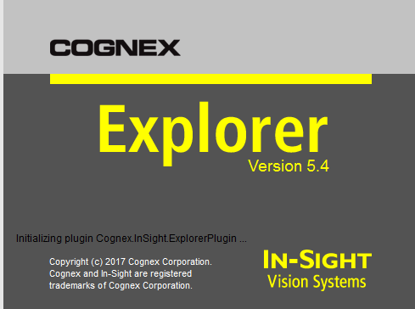
Contact Pattern Fixture: Software Intro
Cognex insight explorer
Image recognition software
Incredibly customizable
Great support
Notes:
Explored Keyence – Not as good

Slide 7
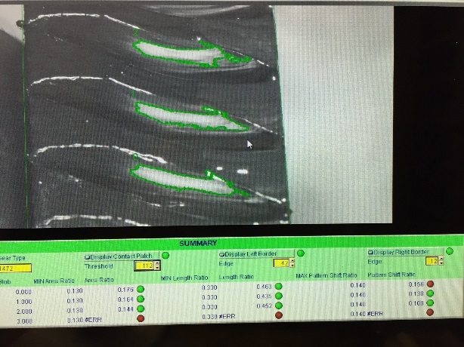
Contact Pattern Fixture: Software Rev1 Overview
Features
Scanned for contact pattern as “blobs”
Measured Pattern shift, Length, and Area Ratios
Pros
Operator and admin window
Cons
Not accurate enough
Loophole to false pass (Consumer Risk)
Function region too large

Slide 8
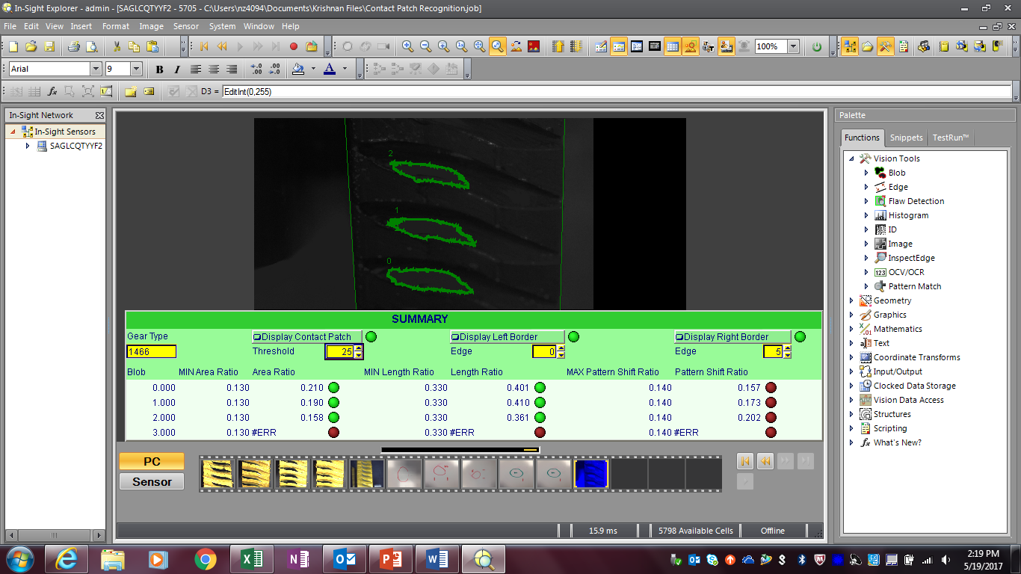
Contact Pattern Fixture: Software Rev1

Slide 9
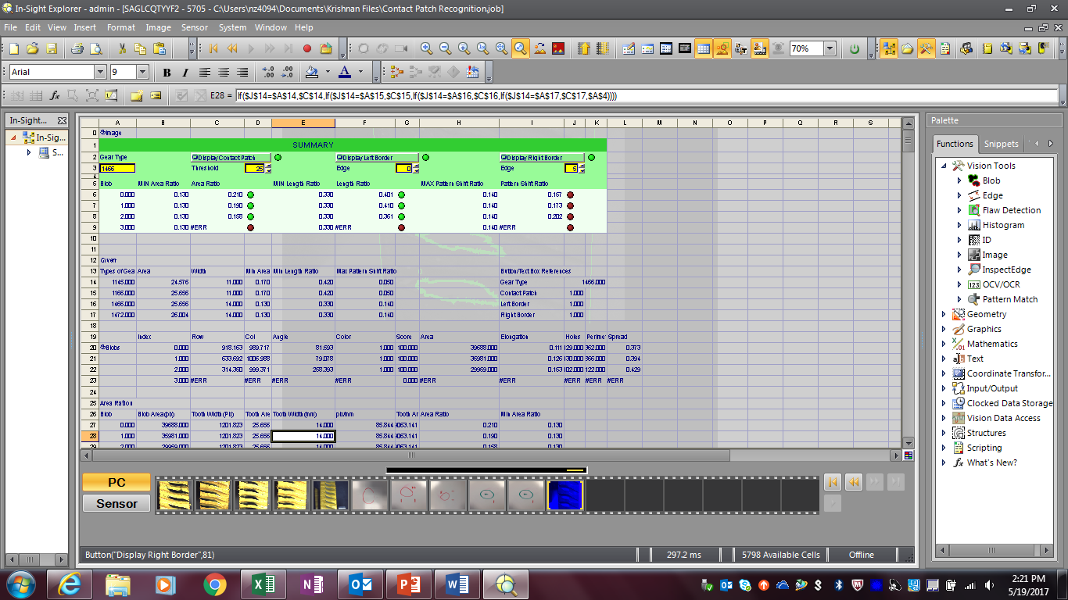
Contact Pattern Fixture: Software Rev1

Slide 10
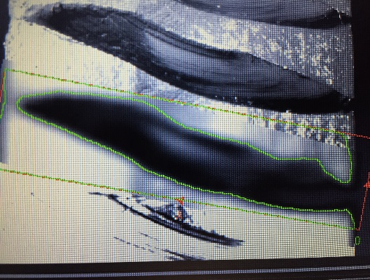
Contact Pattern Fixture: Software Rev2
Changes
Cleaner code
Locate tooth features
Region within region capabilities
Contrast filter function
Area Ratio
Compares pixels between boundaries to actual width (mm)
Pixel/mm ratio obtained

Slide 11
Contact Pattern Fixture: Software Rev2
Rev1 Software was developed using existing hardware
Inconsistent results
Software/Hardware not linked
Rev2 Software tuned together with hardware
More consistent pictures
Fixed lighting
Software/Hardware linked (both Cognex)
“People who are serious about software should make their own hardware”
Alan Kay

Slide 12
Contact Pattern Fixture: Hardware - Purpose
Consistency
Blocks ambient light
Improve Contrast
Blue light
Universal
Ratios and shaft type
Standardization
Repeatable throughout all plants
Minimal adjustability lowers operator error

Slide 13
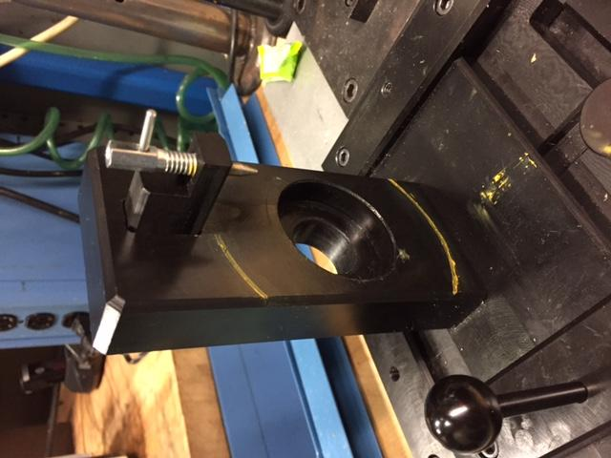
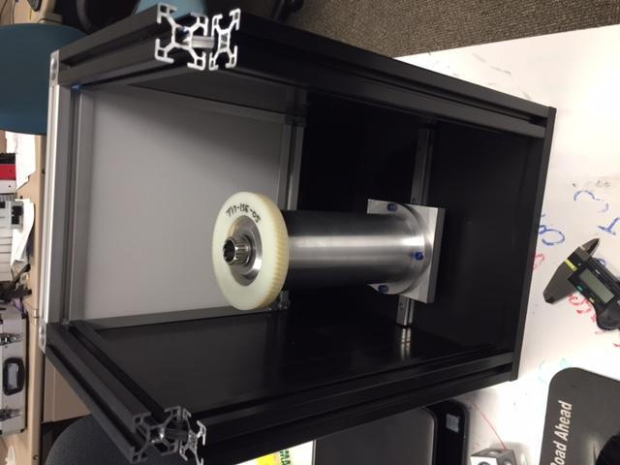
Contact Pattern Fixture: Hardware
Hardware Rev 1
Hardware Rev 2

Slide 14
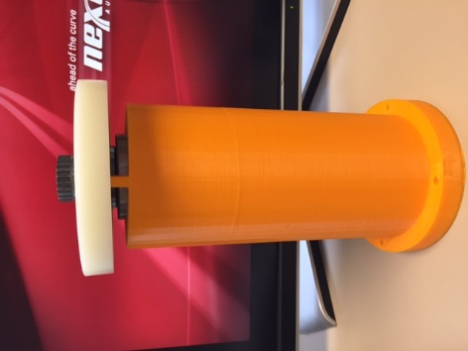
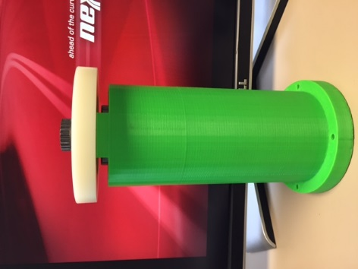
Contact Pattern Fixture: Hardware Rev 2
Gear Holder
Universal to all gears
Radially located with slip fit to bearing
Axially located to small extrusions
Gear Holder Versions
Rev1(orange)
Extrusions too thin
Rev2(green)

Slide 15
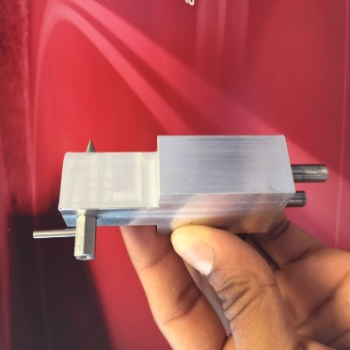
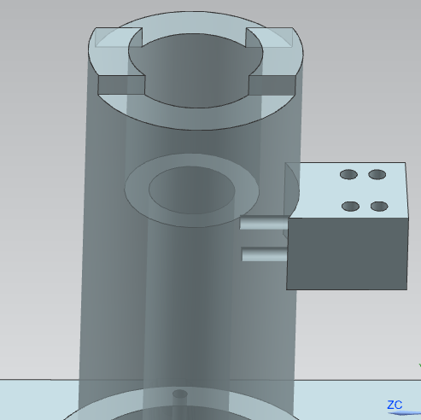
Contact Pattern Fixture: Hardware Rev 2
Gear Pin Mechanism
Spring plunger
Dowel pins locate tower
Two sets of holes on horizontal piece
Allows multiple gear sizes
Performed stacked tolerance analysis

Slide 16
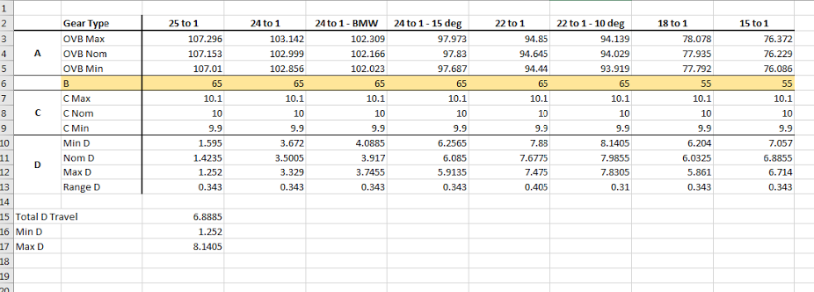
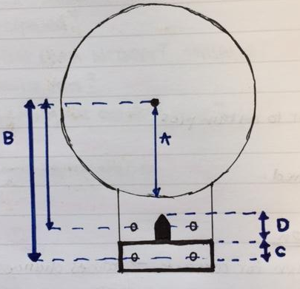
Contact Pattern Fixture: Stacked Tolerance

Slide 17
Contact Pattern Fixture: Hardware Rev 2
Linear Travel & Stops
Gear holder attached to linear rail bearing
Allows for inspection of both flanks
Constrained by stops on both sides
Total travel of 2 inches

Slide 18
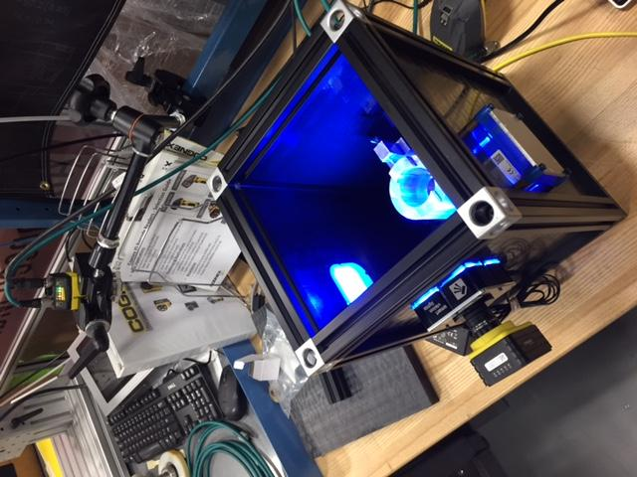
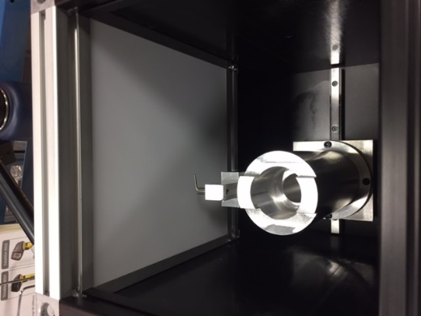
Contact Pattern Fixture: Hardware Rev 2
Lighting Rev1 – Backlight
Pros
Improved boundary contrast
Cons
Poor image
Camera to Light positioning not consistent
Lighting Rev2 – Side and Ring Lights
Pros
Better Images
Better light coverage
Locates camera to fixture
Cons
Multiple lights

Slide 19
Contact Pattern Fixture: Hardware – Parts List
Camera
Cognex 7200
Two Smartvision S75 brick lights
Gear Holder
Adapter plate
Linear rail bearing
Tooth clamping mechanism
8020
8020 Corners

Slide 20
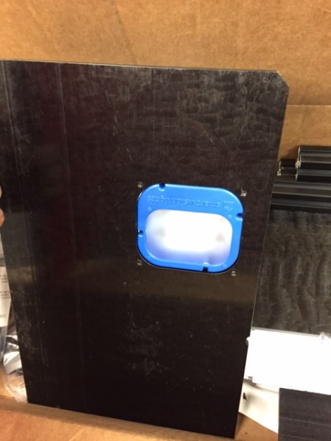
Contact Pattern Fixture: Hardware Rev 2 - Issues
Camera is not fixed radially
Incorporate stops in fixture
Separate holder for camera
Inconsistent brightness on both side lights
S75 connector malfunction
Work with supplier to ensure lights are consistent

Slide 21
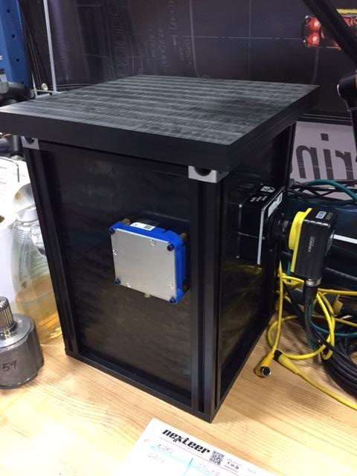
Contact Pattern Fixture: Fine Tuning
Next Steps
Finalizing software
Camera filters
Light Intensity
Notes:
Make software bulletproof

Slide 22
Contact Pattern Fixture: Cost
Approximate prototype cost
Discounts not factored
Multiple builds not factored
Description | Cost
Camera & Software | $ 7,000.00
Lights | $ 1,500.00
Material | $ 400.00
Linear Rail Bearing | $ 50.00
Total | $ 8,950.00

Slide 23
3D Printer: Background
Issues
3D printer was unreliable
Unable to consistently print small parts
Incapable of putting support material where needed
Belt would fall off during the print
Heads are not cleaned regularly

Slide 24
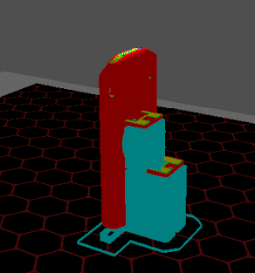
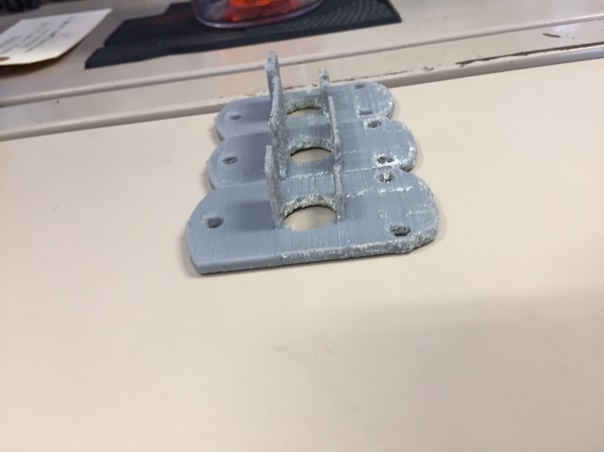
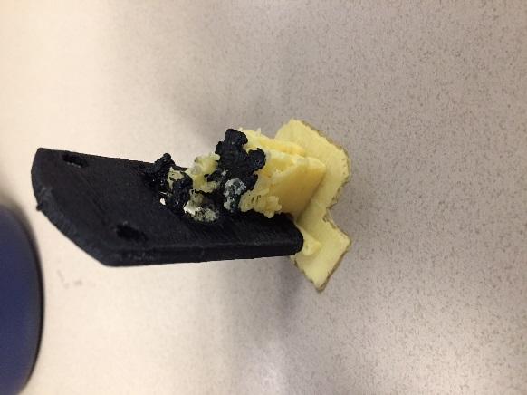
3D Printer: Solutions
APEX software is not able to put support material under small prints
Airwolf recommends not printing small parts
Not capable to this level
Lack of expertise/support from Airwolf

Slide 25
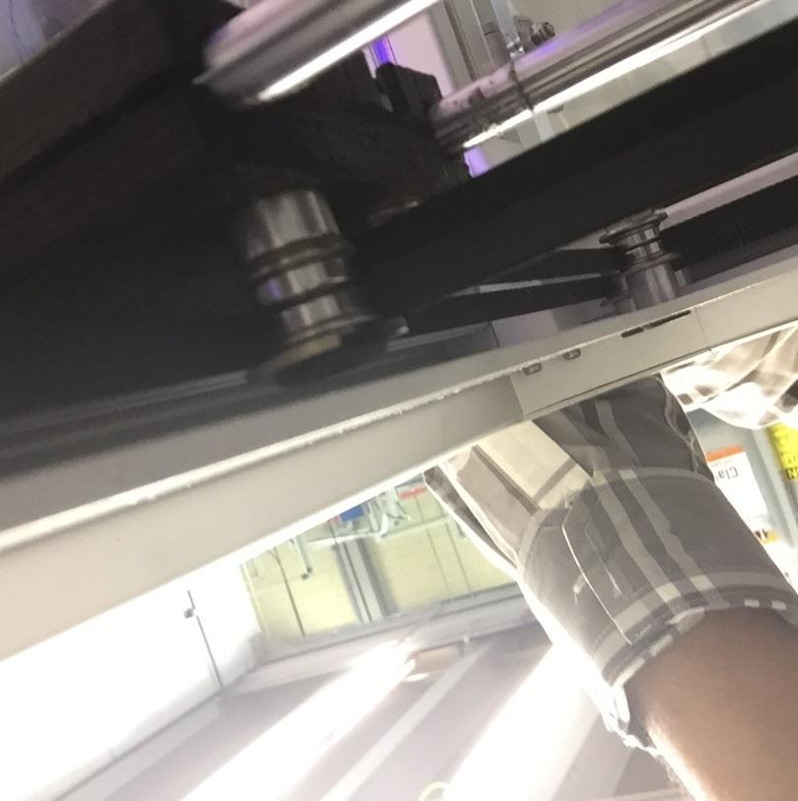
3D Printer: Solutions
Motor and head unit were offset in the z axis
Belt would slide up the roller when printing
Ultimately would fall off resulting in print failure
Added modified washer to the top of the roller
Acts as a stop to prevent the belt from sliding up

Slide 26
3D Printer – Lessons Learned
At a ceiling for print capabilities
Magnitude of prints
Quality of machine
Quality of supplier support
Be diligent with cleaning and maintenance

Slide 27
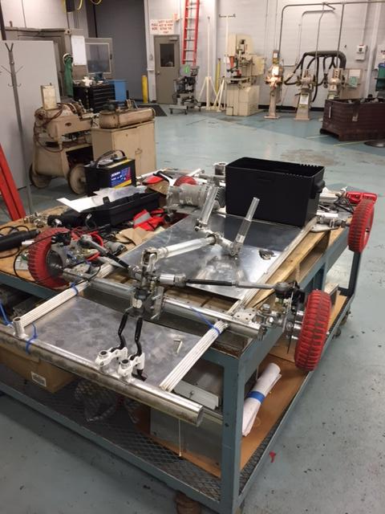
EPS Driven
Team 6 – Intern’ally Built
2nd place going into the main events
4th place overall

Slide 28
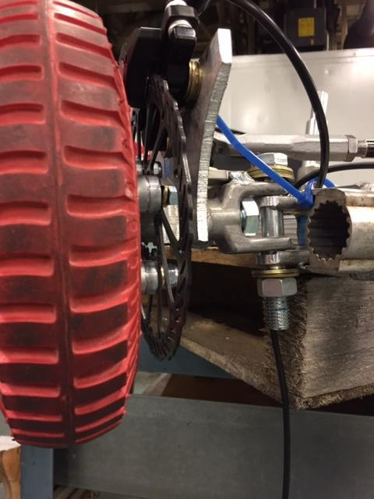
EPS Driven: My Role
Brakes
Alignment
Steering Rev2
Friction reduction
Footstops

Slide 29
EPS Driven: Lessons Learned
Teamwork
Democratic decision making system

Slide 30
Miscellaneous Projects
Run in Stand
Backdrive data
Wear In Study
Bottoming Stands
Wear In Study
Upper Rotor Slip Torque
Tensile Stand

Slide 31
Questions?
Thank you!

